Slide 1
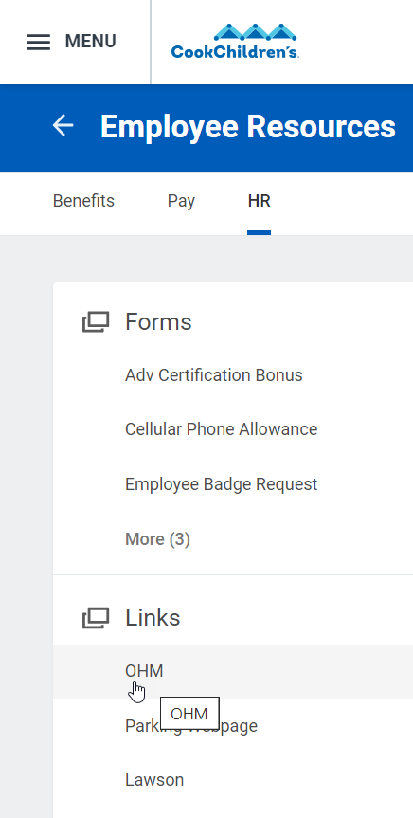
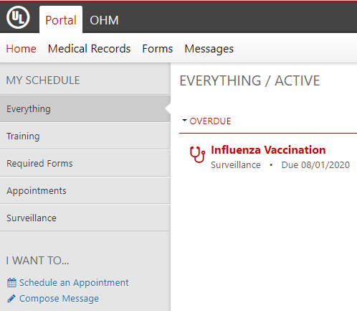
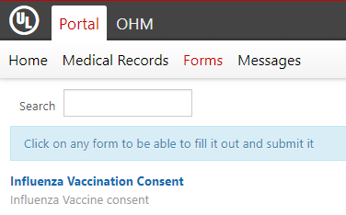
How to complete your online flu vaccine consent
How to complete your Flu Vaccine Consent Online
First, start out in the WorkDay Portal:
Once you are in the Occupational Health Portal, follow these steps to access your online consent form:
In the upper left corner, select the “Forms” tab
Under the “Menu”,
select “Employee Resources”
Next, select “HR tab” and
“OHM under Links.”
Once selected, you will be redirected to the Occupational Health Portal to complete your consent…
Then, select the “Influenza Vaccination Consent.” This will open up an online form to complete and submit.

